Slide 1
Network Security
(Lecture 1)

Slide 2
Agenda
Network Security
Aspects of Security
Threat and Attack
Active vs. Passive Attack
Security Services
Encryption?

Slide 3
Security ?
Confidentiality :
  Assurance that information is shared only among authorised people or organisations
Integrity :
  Assurance that the information is authentic and complete; ensuring that information can be relied upon to be sufficiently accurate for its purpose
Availability :
  Assurance that the systems responsible for delivering, storing and processing information are accessible when needed, by those who need them

Slide 4
Network Security?
Network security is the security measures that are needed to protect data during their transmission.

Slide 5
Aspects of Security
Security attack: Any action that compromises the security of information owned by an organization.
Security mechanism: A mechanism that is designed to detect, prevent, or recover from a security attack.
Security service: A service that enhances the security of the data processing systems and the information transfers of an organization.
  Designed to counter security attacks.

Slide 6
Threat & Attack
Threat
  A person, thing, event, or idea which poses some danger to an asset in terms of that asset's confidentiality, integrity, availability, or legitimate use.
  Threats: Passive [Monitoring but no alterations to the information] and Active [Deliberate alteration of information]
Attack
A realization of a threat; Any action that attempts to compromise the security of the information owned by an organization/person
Categories of Attacks
  Interruption
  Interception
  Modification
  Fabrication

Slide 7
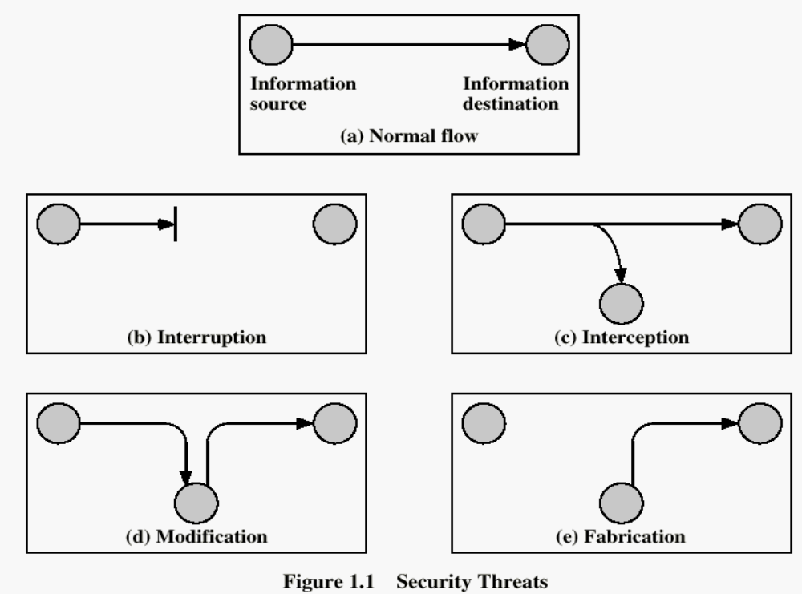

Slide 8
Interruption
Destroy hardware (cutting fiber) or software
Corrupt packets in transit
Denial of service (DoS):
  Crashing the server
  Overwhelm the server (use up its resource)
S
R

Slide 9
Interception
Unauthorized access to information
Packet sniffers and wire-tappers
Illicit copying of files and programs
S
R
Eavesdropper

Slide 10
Modification
Stop the flow of the message.
Delay and optionally modify the message
Release the message again.
S
R
Perpetrator

Slide 11
Fabrication
Unauthorized assumption of other’s identity
Generate and distribute objects under this identity
S
R
Masquerader: from S

Slide 12
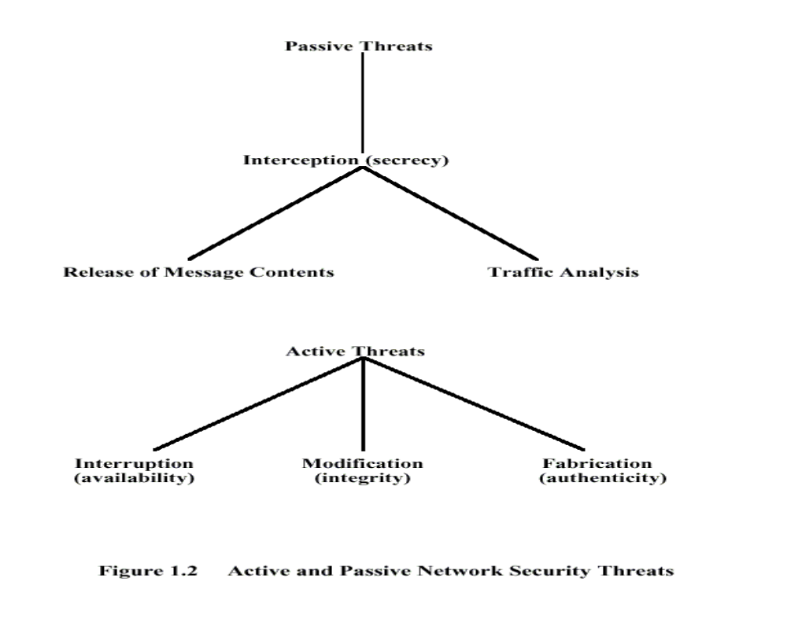

Slide 13
Passive Threats
Release of contents: A telephone conversation, an electronic mail message, or confidential information.
Traffic analysis: Using the location and identities of hosts and the frequency and length of messages to determine the type of communication taking place.
Passive attacks are difficult to detect since they do not involve any alteration of data.
http://uptime.netcraft.com/up/graph?site=www.google.com

Slide 14
Active Attacks
An active attack involve the modification of the data stream or the creation of a false stream.
4 Types of active attacks

Slide 15
Active Attacks Types
Masquerade takes place when one entity pretends to be a different entity.
  This form usually includes one of the other forms of active attack.
Replay involves the passive capture of a data unit and its subsequent retransmission to produce an unauthorized effect.
Modification occurs when an unauthorized party gains access to and tampers with an asset.
  This is an attack on integrity.
Denial of service prevents or slow down the normal use or management of communications facilities.

Slide 16
Security Services (CAIN2A)
Confidentiality is the protection of transmitted data from passive attacks.
Authentication is concerned with assuring that a communication is authentic.
Integrity assures that messages are received as sent.
  A connection-oriented integrity service should assure that there are no duplicates, insertions, deletions, modifications, reordering, or replays.
  A connectionless integrity service deals only with an individual message.
Non-repudiation prevents either the sender or receiver from denying a transmitted message.
Access Control is the ability to limit and control the access to host systems and applications via communications links.
Availability is the ability to prevent the loss or a reduction in availability of elements of a distributed system.

Slide 17
Encryption
Information has to be concealed from an unauthorised person (attacker), so that in the event that it is passively accessed (e.g., copied or intercepted) by an attacker, it should not be useful to them
There are actually two subjects that deal with the concealment of information from unauthorised people:
Cryptography is the study of hiding critical information by encoding it to a unintelligible form using a secret key
  The encoding is commonly called encryption
  If the information is compromised, the attacker should not be able to decode (decrypt) it back to the original information without knowledge of the secret key
Steganography is the study of hiding critical information within some other less important information:
  If the less important information is compromised, the attacker should not be able to even identify, let alone extract, the critical information

Slide 18
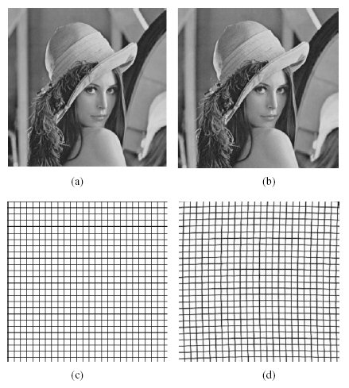


Slide 19
End of Lecture

